Slide 1
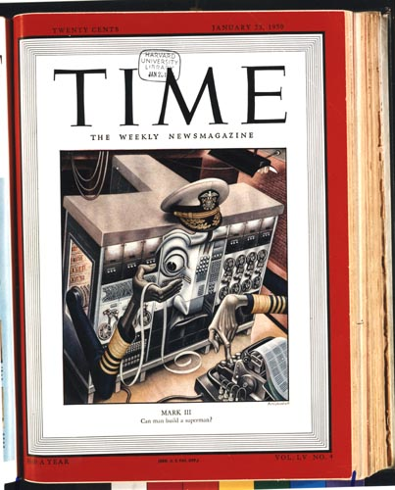
January, 1950
20¢
can man build a superman?

Slide 2
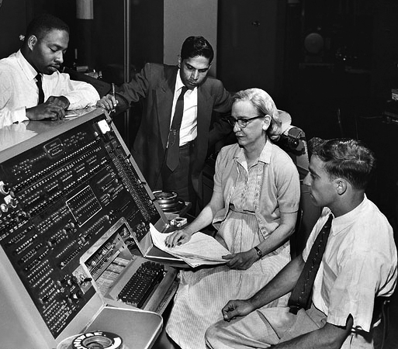
What is a bug?
Admiral Grace Hopper was one of the foremost computer scientists of her day

Slide 3
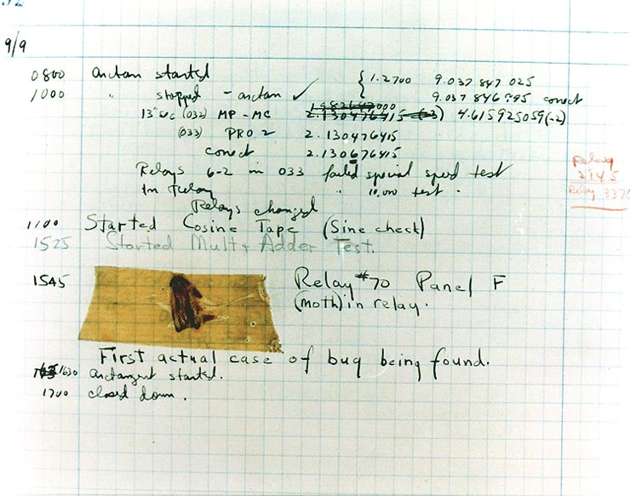
First actual case of bug being found.

Slide 4
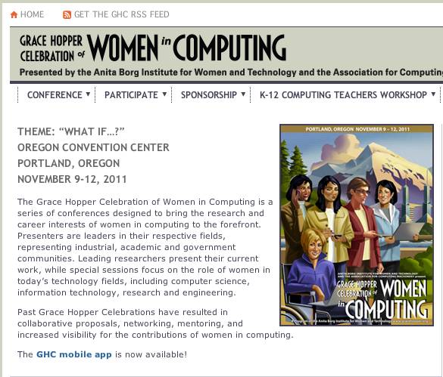
Grace Hopper Celebration of Women in Computing
Computer-scientists gather every year to honor Grace Hopper

Slide 5
Bug Finding
Directions
Open your bug program.
Click run.
Read the error message.
Fix the bug.
Click run again.
Repeat until you have found all of the bugs and the program runs without errors.
Write a sentence explaining each bug on the space provided.

